Slide 1
React with (A)zure
12.10.2019

Slide 2
Wi-Fi
SSID: Zure-Guest
Password: roarwithzure

Slide 3



Quick facts about Zure
The most experienced Azure PaaS partner in Finland
Focus on Azure since foundation 2011
40 employees, eNPS 92
3 Azure Most Valuable Professionals
100% Carbon Neutral 2020

Slide 4





Trainers
Ilpo
Janne
Karl
Monica
Ville

Slide 5
You?
Notes:
Azure expertise? Azure trainings taken or real-life apps built / maintained?
Expectations for the course?

Slide 6
Agenda
10:00 Welcome
10:30 Introduction to React, hands-on labs
13:00-13:30 Lunch
13:30 Introduction to Azure, hands-on labs continue

Slide 7
JavaScript is the world’s most popular programming language
Notes:
Building UI with plain JS is a lot to do
User interfaces has become more interactive

Slide 8
React https://reactjs.org
React is an open-source JavaScript library for building user interfaces
Usually the end-result of React project is a Single-Page-Application
Meaning users can change pages without reloading the browser window
React templates are built using JSX
Meaning HTMLish syntax is transformed to JavaScript
All HTML tags are supported
Attributes do not quite match HTML attributes
React application is a tree of components
Components can contain other (sub-)components
Changes in components are handled by reacting to events
Other frameworks: React Native, Vue, Angular, Polymer, Knockout, Backbone

Slide 9
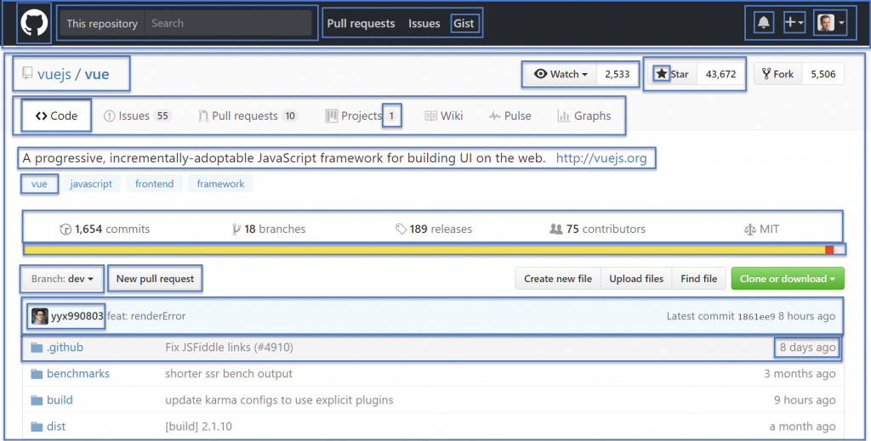

Slide 10
JavaScript module system
A way to use code from another file
CSS and image assets behave like modules as well
Import & export
Makes sharing code more practical
NPM
800k node modules
NodeJS
https://developer.mozilla.org/en-US/docs/Web/JavaScript/Guide/Modules

Slide 11
Coding time

Slide 12
State & Props
Each component has their own encapsulated state
State can be modified and retrieved by accessing values returned from useState hook
Data component receives from other components are called props
Component can then pass its data as props to other components
Props should be treated as immutable data. State can be modified during components lifetime
Parent component sets the props the same way as HTML attributes
E.g. <UserComponent username="johnDoe" />
Child component receives those attributes as props object
E.g. const userName = props.johnDoe

Slide 13
Fetch
JavaScript can send network requests to the server and load new information whenever is needed.
First parameter of fetch is the URL
Second parameter is additional options object
Fetch returns a Promise
Promise either resolves or rejects
Usually used with await/async
let response = await fetch(endPoint);
let commits = await response.json();

Slide 14
Feedback
http://zure.ly/mimmitkoodaa

